Slide 1
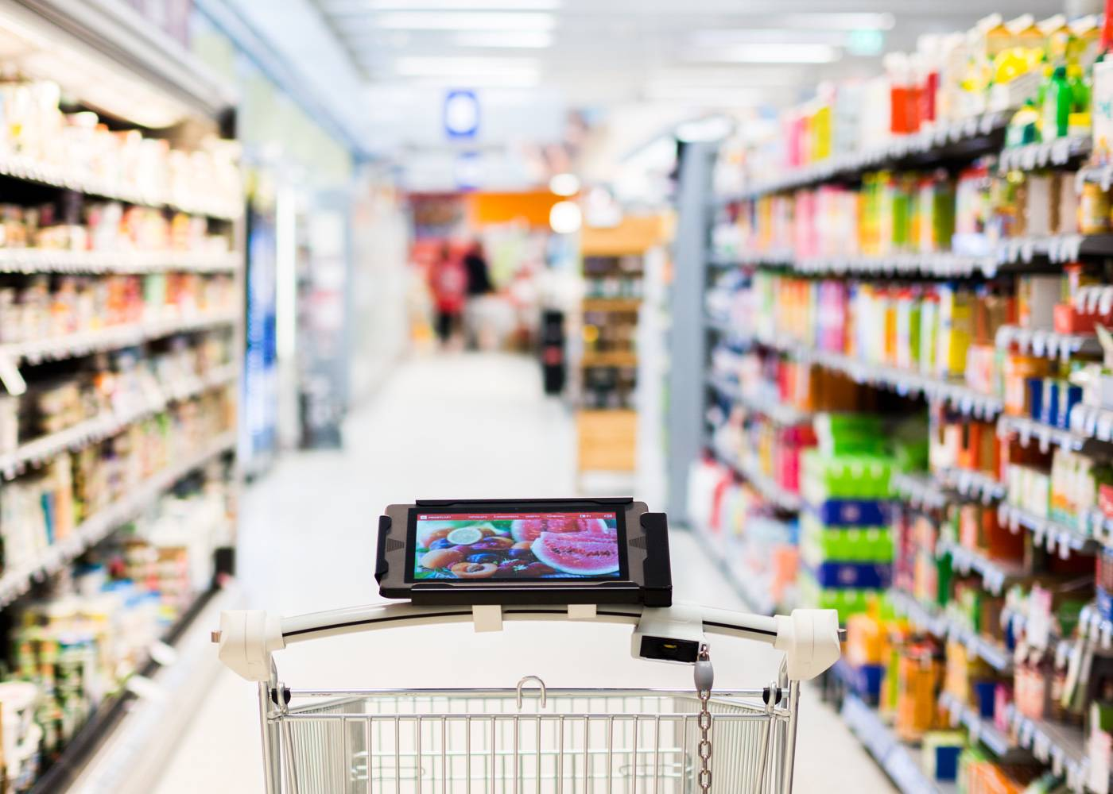
Pick ‘n’ Pay

Slide 2
The Team
Team of University hiring 2019 – Hyderabad
Yamsani Sai Santosh,SY185089
Raj Kumar Sanganabhatla,RS185545
Rithisha Guntupalli,RG185218
Divisha Byreddy,DB185289
Vangari Pallavi,PV185061
Pinnamani Venkat,VP185143
Murali Achanti,MA185357
Arun Kumar,AK185403

Slide 3
Problem Statement
“With the rapid increase in the number of transactions being processed everyday , the long queue of customers waiting to be served by cashier is not an ideal situation. Most people prefer to give up or go away instead of waiting in queue.”

Slide 4
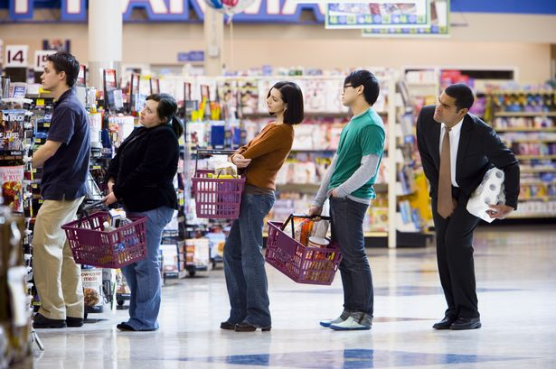
It might take forever ☹

Slide 5
Proposed Solution
To reduce transaction time, improve user experience and providing the best possible offers, we developed a faster checkout mechanism through a mobile application.
Our comprehensive application can increase sales of the store both in terms of immediate impulse buys and future customer loyalty by producing happier customers.

Slide 6
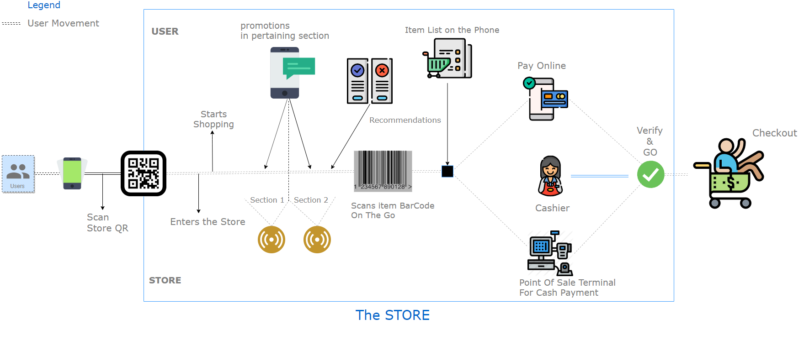
Our Comprehensive Solution

Slide 7
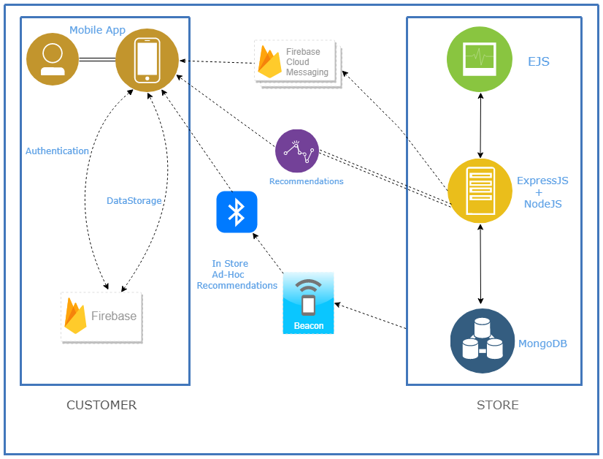
Implementation

Slide 8
Technological Stack
The Sign In and Phone number verification (OTP) is done using Google Firebase.
Notifications are sent to the user by FCM (Firebase Cloud Messaging)
The Store Server is built using NodeJS (MEAN Stack)
The mobile application is built using MVVM Architecture with Live Databinding.
The Web application is built using EJS
The Routing is achieved using Express JS.

Slide 9
Implementation(Customer)
The Android application is built in such a way that, it is
Generic to chain of stores.
As soon as user enters any store, he/she should scan the store QR, in order to get the network details.
Immediately after that, the user would be able to add a item by scanning the QR Code printed on it.
End of the transaction, user can pay through any payment gateway as well as through cash.
For cash, the cashier at the store has to verify the payment and settle the payment through dashboard, which in turn would complete the shopping session of user.

Slide 10
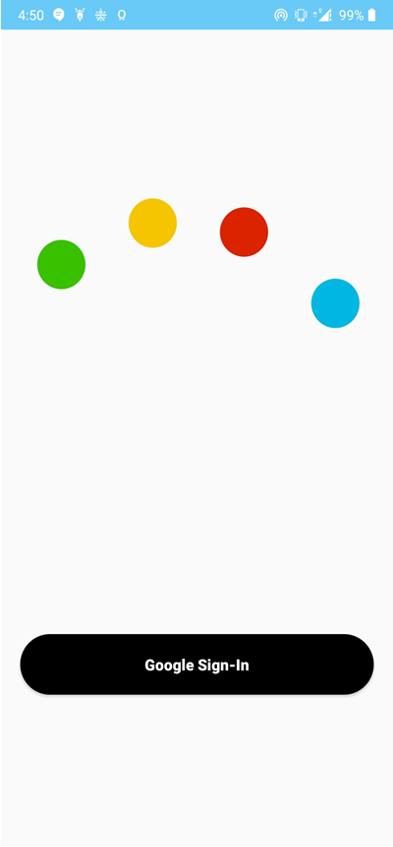
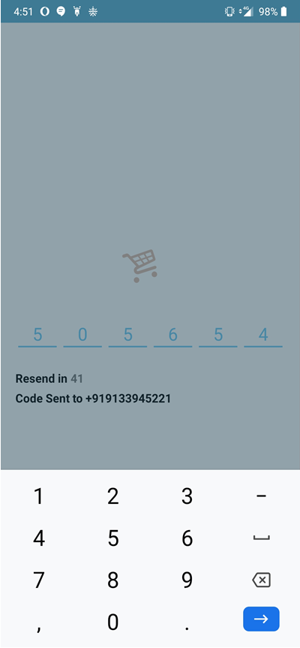
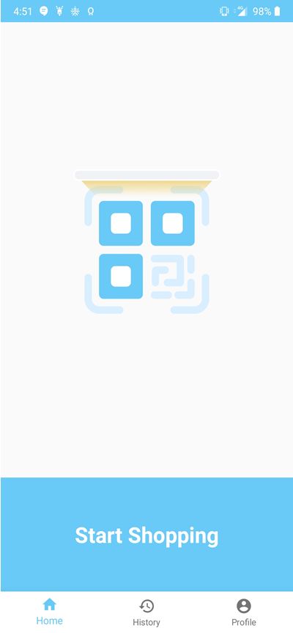
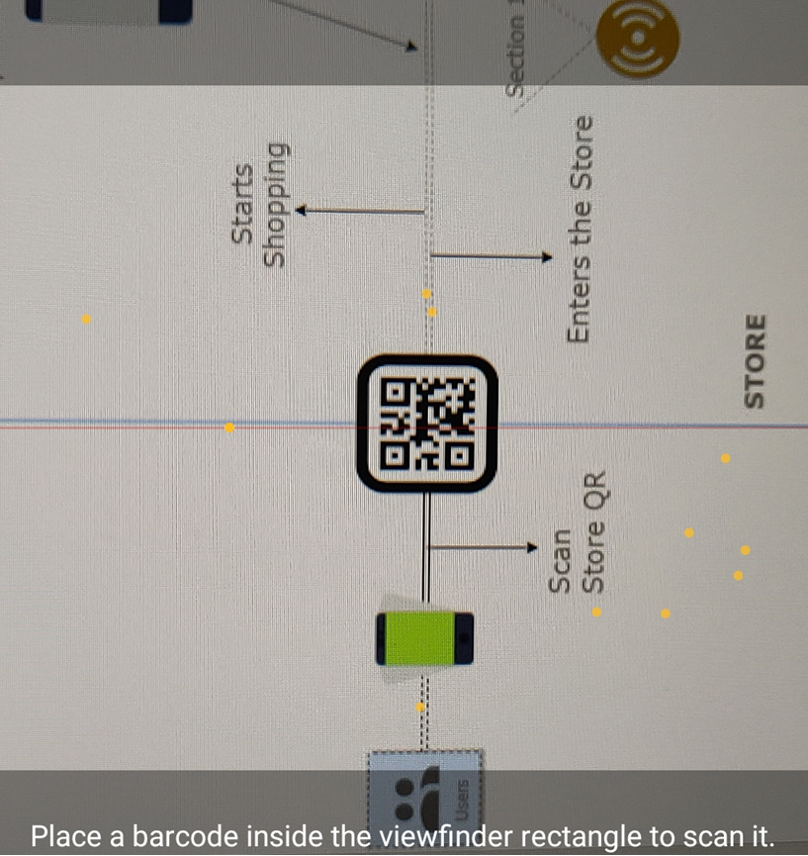
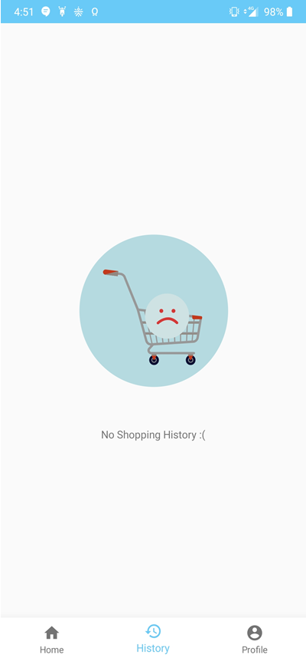
THE APPLICATION
Sign - In
OTP Authentication
Home Page
QR Code Scanner
Purchase History

Slide 11
Implementation(Store)
At the Store, the manager can add/delete/update the items through the dashboard.
Store manager would be able to track the users present in the store, which is built based on the QR scanned by users.
Store manager would be able to settle the payment of user, in case of the cash. This is achieved through Firebase Cloud messaging.
In the dashboard, Store Manager would be able to access the statistics of the store.

Slide 12
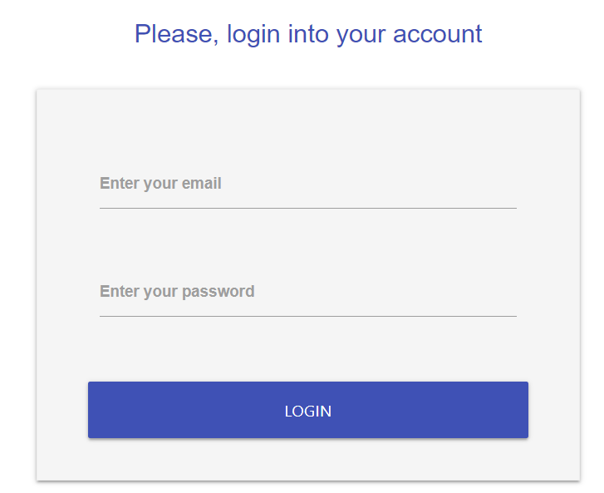
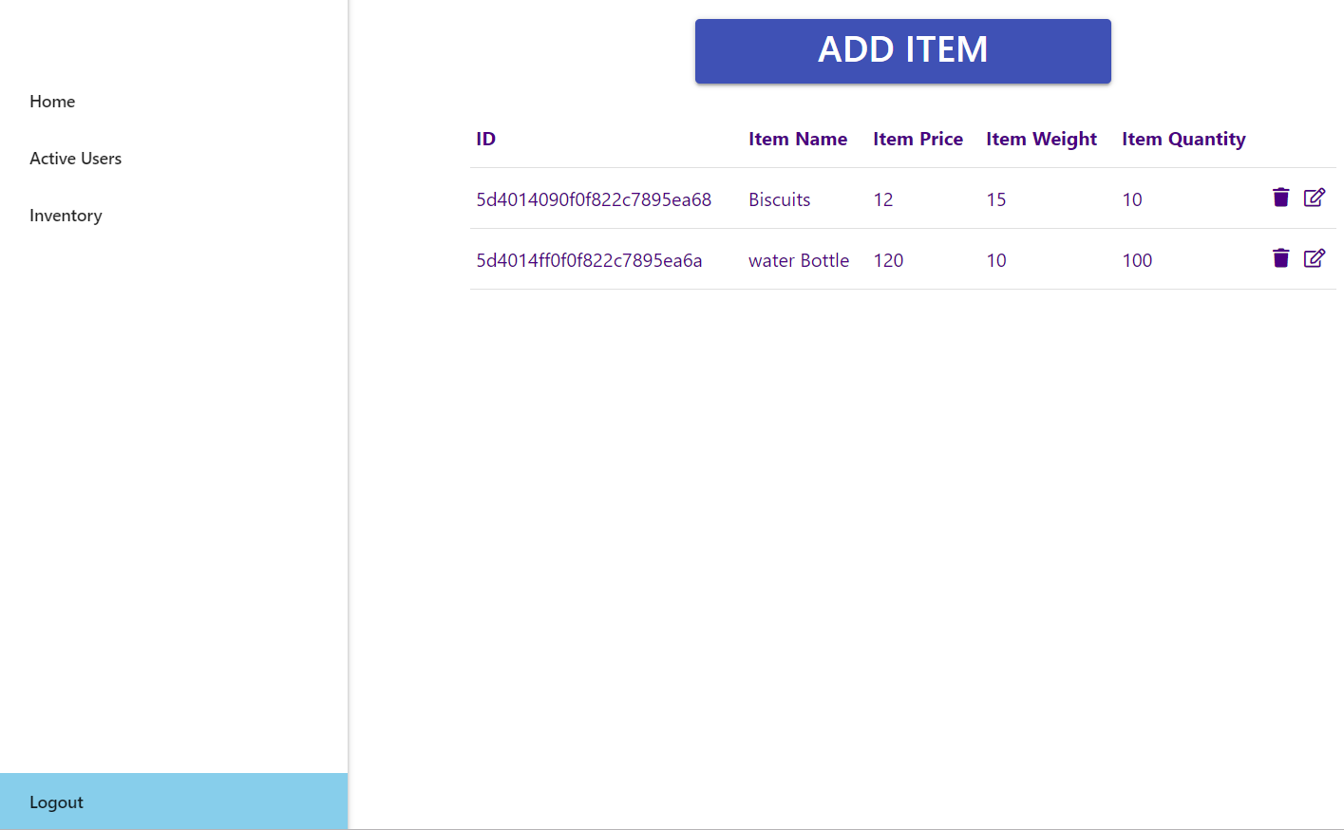
THE SERVER
Manager login
Inventory page

Slide 13
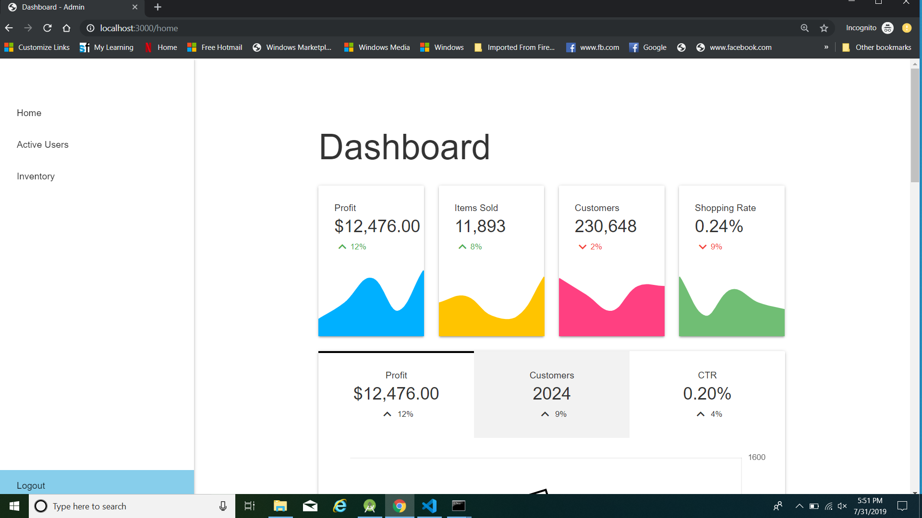
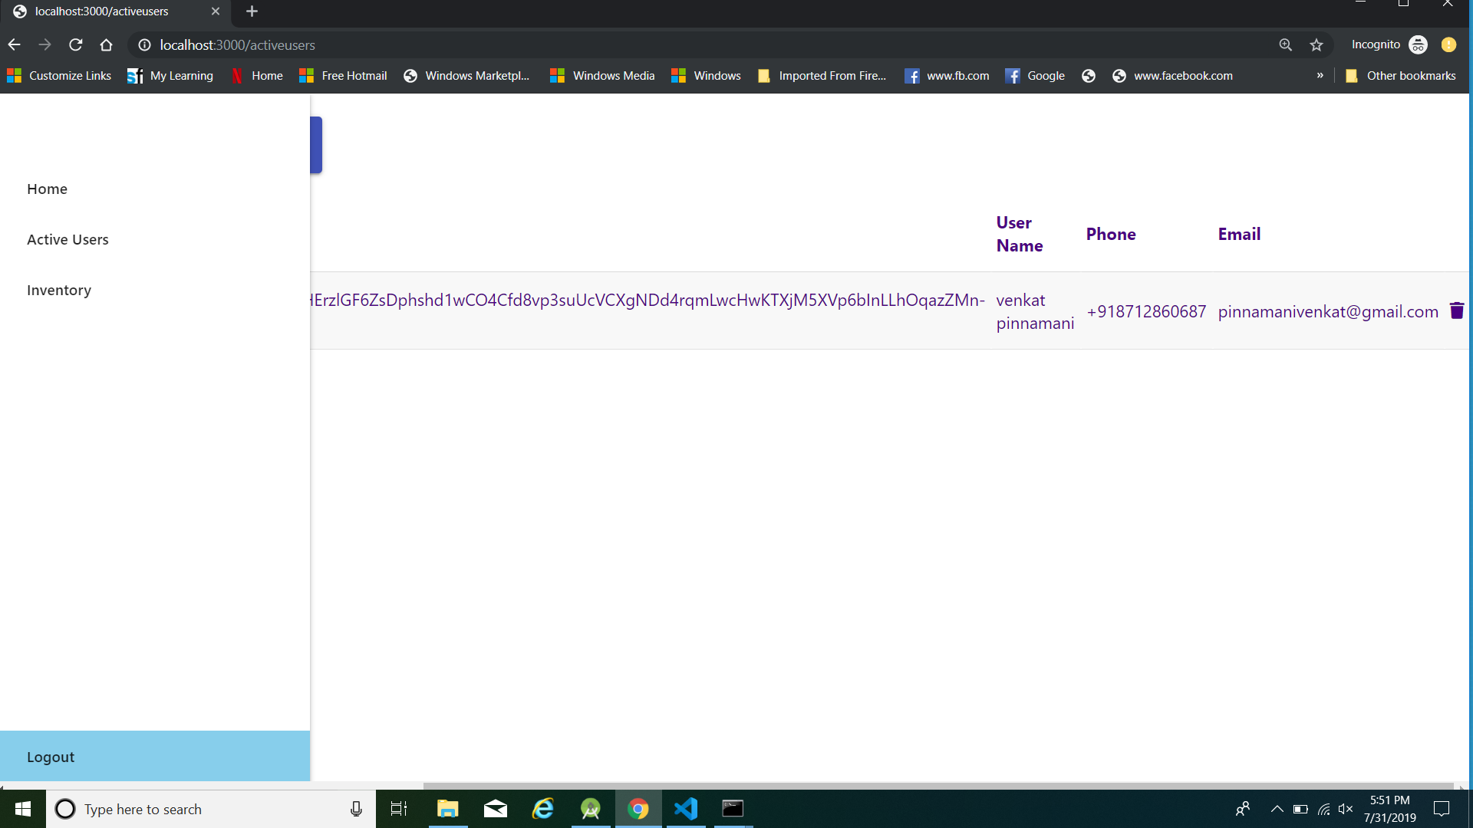
THE SERVER
Dashboard
Active Users Page

Slide 14
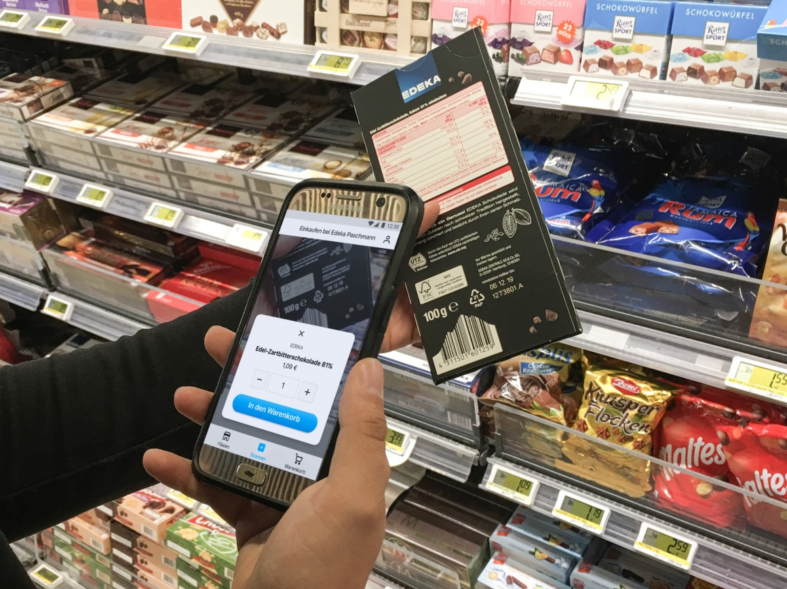
What Makes Our Solution Different?
Unlike the traditional POS systems, we provide.
Customer-centric Shopping Solution Which Is Generic For All Stores.
Minimal Hardware Equipment Required.

Slide 15
​ Reusability​
This application can be adapted according to the necessity of its own environment in order to satisfy the needs of both customers and retailers in almost perfect balance and harmony.​
Every store has data of the items(barcodes, weight etc.) which can be seamlessly integrated with our application without any hassle.
This application can be integrated with any POS, as all it requires is a way to garner the details of the items.
The staff could be employed for verifying at the checkout and other store management tasks without any overhead.

Slide 16
​ Feasibility
As the application is an additional way to checkout it doesn’t disrupt the current POS machines and shopping process.​
Stores don’t need to invest a lot on this application as it doesn’t require extra hardware other than the smart phones and a server.​
Instead of multiple applications for various stores, user could leverage the advantage of using single application across all the stores.
Stores need to just expose a way to access its inventories through a QR code.

Slide 17
​ Innovation Demonstrated
This application is generic for all stores and is customer specific. ​
It provides a one stop place for customers by simplifying the whole shopping process.​
Customers can buy a product or know more about the product by scanning the product’s barcode.​
Offers, which are specific to a customer based on his/her shopping patterns can be sent as notifications to the app.​
Leveraging the power of machine learning to provide recommendations, fraud detection, Optical Character Recognition(OCR).
Beacons to measure proximity for recommendations based on the section in the vicinity.

Slide 18
​ Immediately relevant​
​Nowadays we find huge rush in every retail store which signals a need for a new shopping process that can save the time of the customers spent in the long checkout queues.
​This application improves the customer experience which is highly needed for the retail stores to sustain in this competitive world.​
It would only require minimal time of 1 or 2 days to set up our comprehensive solution.

Slide 19
​ Impact to business​
NCR Could expose Store Level API, using which the user need not go to any store, and can shop from remote location.
It improves NCR’s interaction with their customers, as well as improvise store’s shopping experience.
Our application can increase sales of the store both in terms of immediate impulse buys and future customer loyalty by producing happier customers.​
It increases staff productivity thus decreasing their costs by efficiently matching staff members to customers.
​Provides management data about their customers and their interests, which can help them in competitive marketing.​

Slide 20
Advancements
Using the data, NCR could improvise on the loyalty schemes.
Predict the trend patterns and effect of external patterns on business.
In store beacons, which could notify users with offers based on the current location in the store i.e., nearest section.
Handwriting recognition integration to generate the list of items from a hard copy.
Recommendations based on shopping pattern, by leveraging the data from his previous purchases.
Suggestions based on the occasion.
Fraud Detection to avoid shoplifting or any other malpractices.

Slide 21


